Slide 1
Welcome to our class!
MIS 6311-501
Cyber Security Fundamentals
Chris Davis

Slide 2
Session 01 – Course Overview
MIS 6311-501 Cyber Security Fundamentals
Chris Davis

Slide 3
Housekeeping
Any Questions? Please do not hesitate to email. Or text.
Class Website: https://elearning.utdallas.edu
Dropbox: https://goo.gl/9AFyoE
UTD Email: cmd140430@utdallas.edu
Gmail: davischr2@gmail.com
Google Voice: 214-771-8122 (Text & Emergencies)
LinkedIn: www.LinkedIn.com/in/ChristopherDavis
Blog: www.cloudauditcontrols.com
Class: Monday 7:00pm-9:45pm JSOM 12.210

Slide 4
Session Overview

Slide 5
MIS 6311-501 Cyber Security Fundamentals
About the Class & Setting Expectations

Slide 6
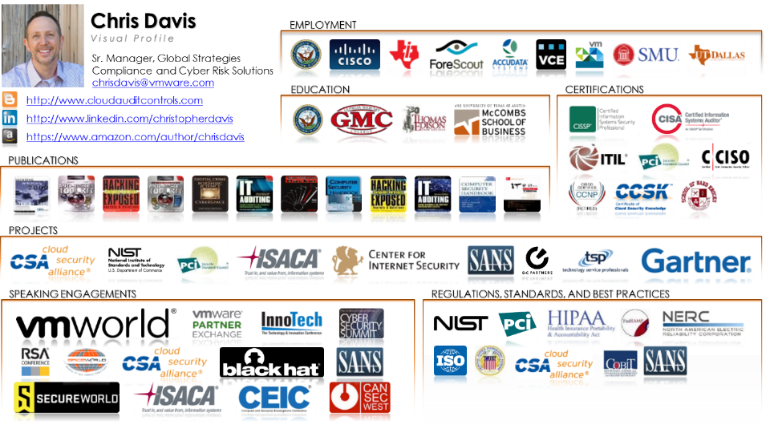
Your Instructor – Chris Davis
Secure Chip Design
Product Manager
Security Operations
IT Auditing
NAC Engineer
Compliance and Assessments
Cloud Security Architect
Virtualization Compliance

Slide 7
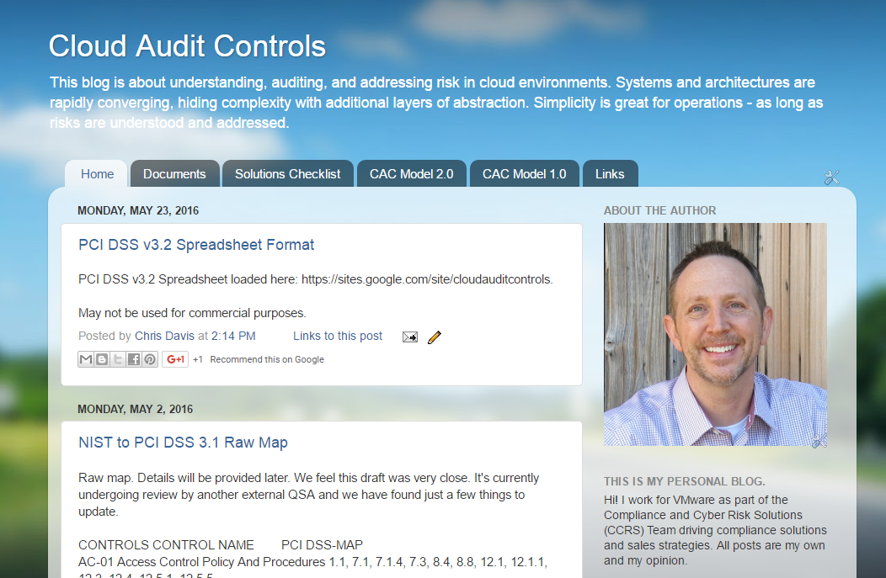
http://www.cloudauditcontrols.com/

Slide 8
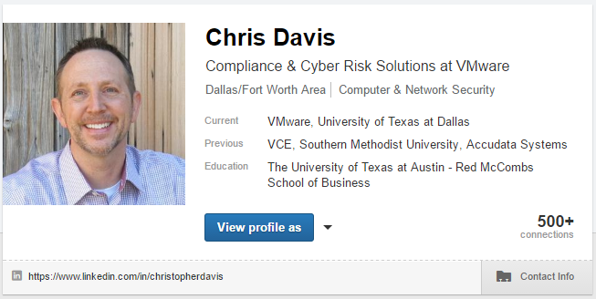
https://www.linkedin.com/in/christopherdavis

Slide 9
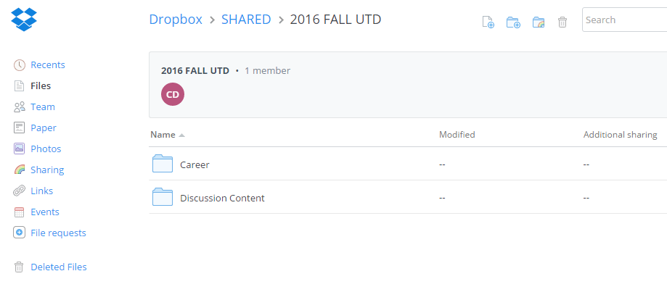
https://goo.gl/9AFyoE

Slide 10
What this course IS and IS NOT
IS
Breadth
Management concepts
Design and architecture
Designed for your future growth and leadership
IS NOT
Hacking Course 101
Programming in C# or Perl
Configuring rhosts on a Solaris box
Troubleshooting a firewall
LET’S BE CLEAR.
Technology, audit, engineering,
or military (technical discipline) background REQUIRED.
Notes:
Student Learning Objectives/Outcomes
Very simply, in plain English, students of this course acquire practical knowledge that forms the foundation for additional studies in a variety of information security disciplines.
This is a graduate level course, and many of the students are working professionals – as is the instructor. You can apply this knowledge directly and indirectly to your company projects.

Slide 11
Eight Goals for This Course
Establish cautions of use of this talk and material
Conceptualize content clearly
Speak plainly
Frame a range of information security concepts
Describe the application of learned security concepts at the enterprise level
Establish some present & future information security challenges
Stimulate the exchange of ideas
Answer your questions fully
Boiler Plate Agreement

Slide 12
The CISSP
CISSP definitions are from https://www.isc2.org/cissp-domains/default.aspx
Default standard certification for security practitioners.
Responsible for giving me the right perspective of information security and has shaped my approach

Slide 13
Comparison of Our Class to CISSP Domains
Shon Harris Book – Chapters
Current CISSP Domains
2
Information Security Governance and Risk Management
8
Business Continuity and Disaster Recovery Planning
Security and Risk Management
9
Legal, Regulations, Investigations and Compliance
7
Cryptography
Security Engineering
4
Security Architecture and Design
Security Assessment and Testing
5
Physical (Environmental) Security
Asset Security
6
Telecommunications and Network Security
Communications and Network Security
3
Access Control
Identity and Access Management
11
Operations Security
Security Operations
10
Software Development Security
Software Development Security

Slide 14
Academic Calendar & Sessions

Slide 15
Let’s Review the Syllabus.

Slide 16
Grading, Materials, and Course Project

Slide 17
Course Structure & Grading
Course Requirements Summary:
Category | Weight | Comments
Class Participation | 25% | Class Assignments (Pop Quiz) and Participation
Project | 25% | Students may choose one of the following options: Subject Area Analysis Data Breach Analysis Risk and Controls Analysis
Exam 1 | 25% | Midterm Exam
Exam 2 | 25% | Final Exam

Slide 18
Materials
Required Textbooks and Materials
CISSP All-In-One Exam Guide http://www.amazon.com/dp/0071781749/
What version of the text you buy, whether hardcover or Kindle edition, is completely up to you. Highly recommend the exam questions if this is a professional certification that you would be interested in taking in the future.

Slide 19
Project Details
Examples of Excellence…
http://www.cloudauditcontrols.com/2015/12/cybersecurity-fundamentals-top-3.html
Choose One:
Subject Area Analysis and Presentation
Data Breach Analysis and Presentation
Risk and Controls Analysis and Presentation
Deliverable Format: The deliverable should be a concise written overview 4-5 pages in length. If needed, you can exceed 5 pages as long as the writing is concise and well focused. Quality > Quantity.
Production Units: One electronic or paper copy per self-selected team.

Slide 20
Subject Area Analysis
Prepare an analysis of a relevant topic or subject area germane to the course.
Topics may be chosen from any class session content description in the syllabus.
The purpose of this analysis and presentation is to dive deeper into a subject area.

Slide 21
Data Breach Analysis
Analyze risks and control failures that led to a known data breach
Details should include a descriptive chronology of what happened and how effective security and risk management programs could have been effective in mitigating the risk that led to the breach.
http://www.informationisbeautiful.net/visualizations/worlds-biggest-data-breaches-hacks
http://krebsonsecurity.com/category/data-breaches
http://datalossdb.org/
http://www.databreachtoday.com/breaches-c-318
http://www.privacyrights.org/data-breach
http://www.forthepeople.com/class-action-lawyers/data-breaches/chronology

Slide 22
Risk and Controls Analysis
Students will demonstrate understanding and analysis capabilities by choosing either a subject area, technology, or a designated system to detail actual or typical implemented controls and residual risk.
The purpose of this analysis is to demonstrate conceptual familiarity and practical application of risks and controls.
Example – Here's the technology. It does… Here's how it is protected… Here are the gaps… These represent residual risk. You can reduce residual risk by doing the following…

Slide 23
Housekeeping

Slide 24
Class Rules
Food and Drinks
Participation ENCOURAGED
Acceptance and Open Forum
Learning Styles
Special Needs
Breaks

Slide 25
Facilities
Restrooms
Exits
Food
Concerns & Questions

Slide 26

Community. Village raising a warrior.

Slide 27
Your Turn.
Community of Professionals – Share Knowledge
Name
Where are you from?
Career Goal

Slide 28
A Walk on the Wild Side. Tales from the Crypt.
Practical Applications & Lessons Learned.

Slide 29

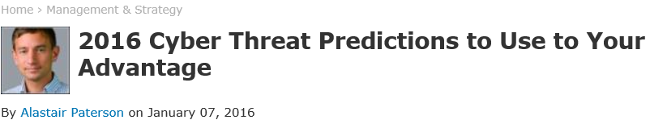
1. Attribution remains murky.
2. Ransom continues to rule.
3. More attackers share the global stage.
4. Criminals follow the money.
5. Hacktivists get more sophisticated.
6. Dark web marketplaces scramble for leadership.
7. Attacks on the retail industry evolve.
http://www.securityweek.com/2016-cyber-threat-predictions-use-your-advantage
Notes:
1. Attribution remains murky. Last year both the variety of threat actors and the ability to neatly “classify” these actors into types became much more difficult as attack behaviors changed, and motivations and threats increased in their complexity. Actors no longer work in set groups, but combine with others, involve multiple individuals, and use facades to hinder attribution. This all but ensures that attribution will be even more challenging in 2016.
2. Ransom continues to rule. Extortion as a mode of attack became a popular tactic for threats actors in 2015, and on a few occasions attackers have taken it to the level of demanding that businesses shut down entirely. Having proven that this is a profitable enterprise, attackers will likely further innovate their business models based on ransom and extortion in 2016.
3. More attackers share the global stage. Advanced attack methods, such as custom malware or unusual attack vectors, were historically the domain of nation states with significant engineering capability; often those states that have or are developing a nuclear defense capability. In 2015, non-nuclear states and organized criminal groups adopted these techniques thanks to lower barriers to entry and the increased trade in espionage capabilities. We can safely expect that in 2016 non-nuclear states will continue to develop their cyber capabilities and compete on the global stage.
4. Criminals follow the money. Organized criminals are focusing more intently on high value targets that provide a large value single payout. This is in contrast to the traditional consumer-focused malware approach that these groups have exploited in the past. This is highlighted even more with the Carbanak/Anunak attacks. Examples of high value/low volume transactions that may be targeted in 2016 are payroll, mortgages, and investment transactions.
5. Hacktivists get more sophisticated. Hacktivists continue to be motivated by embarrassment of their targets, but their tactics are no longer simply DDoS, doxing, and defacement. In 2015 hacktivists stole and published data in order to attract awareness to their cause, continuing to embarrass their targets despite the collateral damage. In 2016 hacktivists will use more tactics, techniques and procedures that were previously considered the preserve of cyber criminals.
6. Dark web marketplaces scramble for leadership. Global law enforcement will continue to takedown large dark web marketplaces. This will likely lead to a fragmentation of the market and rival marketplaces scrambling for pole position. This means that in 2016 we can expect the dark web will move to employ overlay networks other than Tor.
7. Attacks on the retail industry evolve. Spurred by the recent requirements for EMV chip card compliance, cyber criminals will continue to develop more sophisticated Point-Of-Sale (POS) malware.

Slide 30
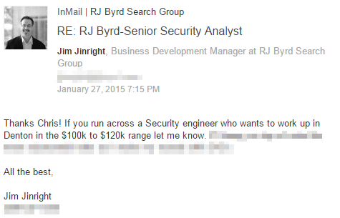

Slide 31

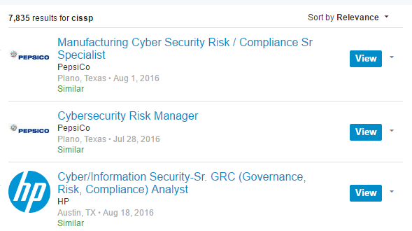
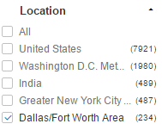
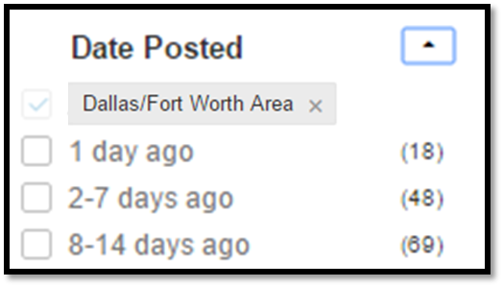
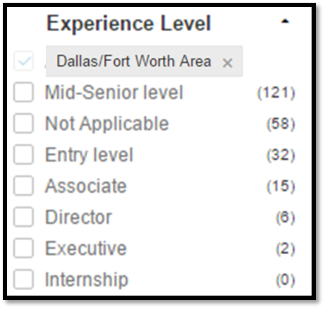
Help me get a job!

Slide 32
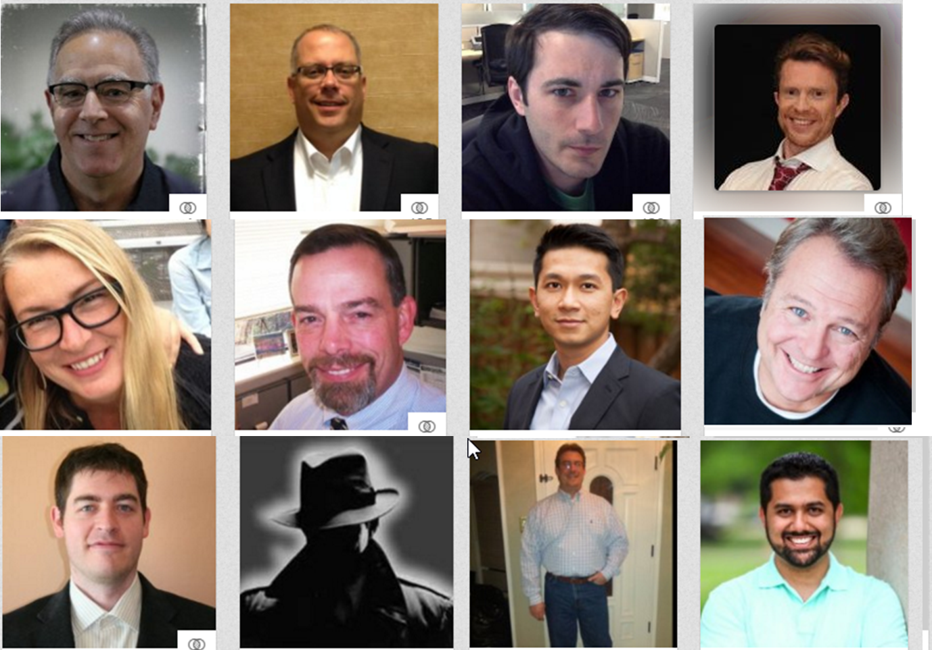

Slide 33
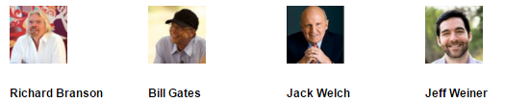
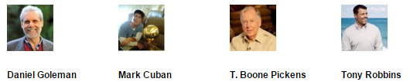
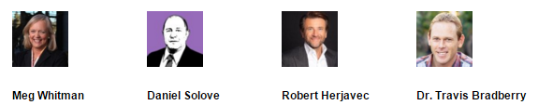

Slide 34
Let’s Get Started.

Slide 35
Chris's View

Slide 36
GRC and IT Controls; Building the Security Program
MIS 6311-501 Cyber Security Fundamentals
Chris Davis

Slide 37
Practical Application
IT Controls. GRC. Why do you care?
Presentation delivered at RSA London.
This is a blessedly shortened version.

Slide 38
Why does this class exist?
Let’s Review a Real-World
Typical Presentation.

Slide 39
10 MINUTE BREAK!

Slide 40
GRC & IT Controls
Chris Davis, Mike Schiller

Slide 41
GRC Quick Recap
G
C
R
Governance, Risk, & Compliance

Slide 42
Governance, Risk, Compliance
G
Maturity – maintain over time, preserve operations
Stakeholder-Driven
R
Business Requirements – prevent compromise, data loss, downtime
Business-Driven
C
Minimum Requirements – prevent fines
Data-Driven
Common Objective
Protect data, business, risk, Confidentiality, Integrity, Availability (CIA)
What
REGULATION
STANDARD
BEST PRACTICE
Driven by
US FISMA
MULTIPLE PARTIES
Who
NIST
PCI-SSC
ISO
CSA
ISACA
Authority
FedRAMP
HIPAA
CJIS
IRS 1075
PCI-DSS
27K
CAIQ
CoBIT
How
Properly Implemented Controls.

Slide 43
Hundreds of Authority Sources
Sarbanes Oxley (PCAOB, SAS 94, AICPA, Sec 17, COSO ERM, A123)
Banking and Finance (Basel II, Gramm Leach Bliley, GLBA, FFIEC)
NASD NSYE (Sec 17)
Healthcare and Life Science (HIPAA, NIST, CMS, FDA)
Energy (FERC, NERC)
Credit Card (PCI DSS, Visa CISP, Amex, MasterCard, BBB)
Federal Security (E Sign, UETA, FISMA, FISCAM, FIPS, Clinger Cohen Act, GAO, DOD, CISWIG, OMB, NCUA, CTPAT, more)
IRS (Rev Proc 97 22, 98 25, 501c3)
Records Management (ISO, DIRKS, Sedona, more)
NIST (800 14, 18, 26, 30, 33, 34, 40, 41, 53, 60, 61, 64)
General (Cobit 3 & 4, NFPA, ISF, ISSA, CERT, IIA, more)
US Federal Privacy (Cable, Telemarketing, SPAM, COPPA, Drivers, Family, Video Privacy, Spector Leahy, more)
US State Laws (all states)
System Configuration (CI Security for Solaris, HP UX, Red Hat, SuSE, AIX, NIST Novell, Apple OS X, Vista, DISA, more)

Slide 44
Controls Quick Recap

Slide 45
Information Security Controls
Technical | Access Control Systems, Two-Factor Authentication, Firewalls, Encryption Systems, Uninterruptible Power Supplies, Intrusion Detection Systems, Anti-Virus Software, Redundant Systems or System Components, Back-up Systems, Audit and Logging Systems, System Hardening
Physical | Security Guard, Key-Card Physical Access Systems, Alarm Systems, Safes, Fire Suppression Systems, HVAC Systems, Fences, Lighting, Security Cameras
Administrative or ‘Process’ | Acceptable Use Policy, Business Continuity Plan, Password Policy, Incident Response Plan, System Baseline Configurations, Remote Access Policy, File Recovery Procedures, Information Classification, Information Security Training and Awareness, Audits and Assessments

Slide 46
Pulling these Concepts Together
Governance does NOT equal IT Controls
IT Governance seeks to ensure IT is aligned with business objectives.
Risk does NOT equal IT Controls
Risk management seeks to identify threats to the objectives of the business and then avoid, mitigate, or transfer risk.
Compliance does NOT equal IT Controls
Compliance programs ensure that the requirements of laws, regulations, industry codes and organizational standards are met. (alt. seek to detect and prevent criminal misconduct)
IT Controls are necessary tools to support GRC functions.

Slide 47
Effectively Managed IT Controls
Technology can affect every part of the business.
At its best, technology is a competitive advantage.
At its worst, technology is your competitor’s advantage.
Product
Market Relationships
IT Controls:
Detective, protective and reactive measures in place to protect the confidentiality, integrity, and availability of business information and ensure appropriate management of the IT function to meet business objectives.
Inbound Logistics
Operations
Outbound Logistics
Marketing
and Sales
Service
Firm Infrastructure
HR Management
Margin
Procurement
Technology Development
Notes:
Compliance Control: A process, effected by management and other personnel, designed to provide reasonable assurance that transactions are executed in accordance with 1) laws governing the use of budget authority and other laws and regulations that could have a direct and material effect on the financial statements or required supplementary stewardship information and 2) any other laws, regulations, and government wide policies identified in OMB audit guidance. [GAO/PCIE Financial Audit Manual]
Source: http://www.unifiedcompliance.com/it_compliance/language_compliance/definitions/c.html

Slide 48






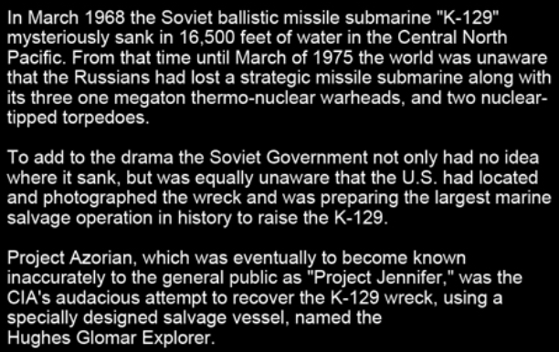

Images Source: http://www.white.at/projectjennifer/images/forumad/Azorian_forumad.jpg
Notes:
To this day, Project Azorian is the deepest ocean salvage operation ever attempted and challenged a team of Americas elite marine and aero-space companies to design a unique system to solve an incredible problem, how do you lift to the surface a damaged 1,700 ton segment of submarine from a depth of 3 miles while being observed by a paranoid and well-armed Soviet intelligence organization?

Slide 49
Building an Information Security Program
EMIS 7382: Information Security and Risk Management
Chris Davis

Slide 50
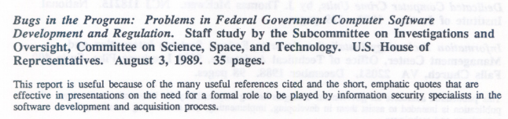
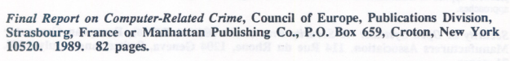
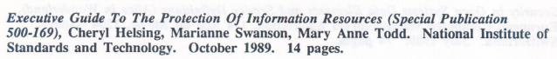
Some things haven’t changed as much as you would think they *must* have changed…

Slide 51
ATSEC APPROACH to Security Program
Simple Primer from our Austin Boys on Building an ISO27000 Program.
http://www.atsec.com/downloads/documents/ISMS-Implementation-Guide-and-Examples.pdf

Slide 52
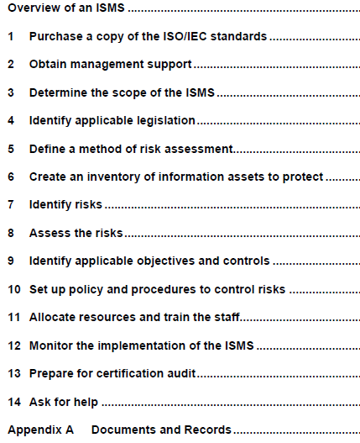
ISMS Implementation Guide
Target is ISO27000 Certification.
Beauty is in the directness and simplicity lacking in most academic materials.
Reads with maturity and understanding of someone that has “been there.”

Slide 53
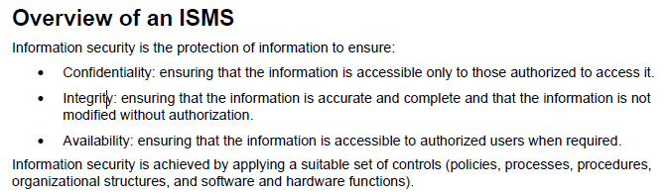
Overview of ISMS

Slide 54
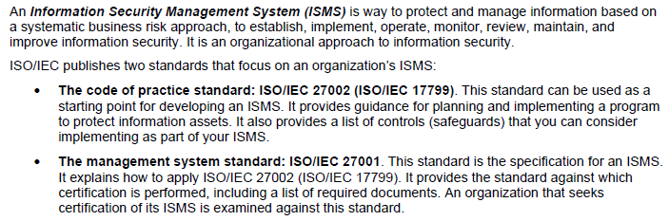
ISO Standards

Slide 55
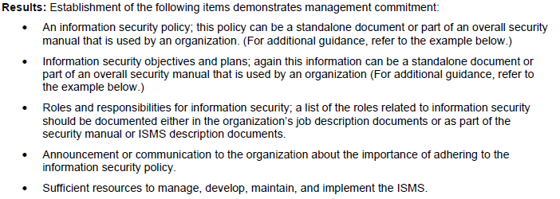
Management Support

Slide 56
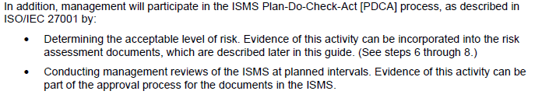
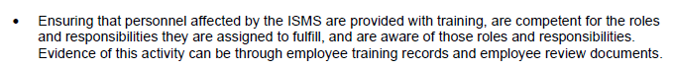
Management Support

Slide 57
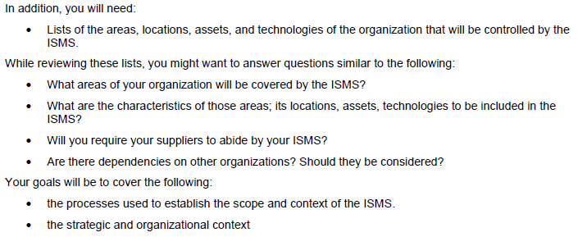
Determine Scope

Slide 58
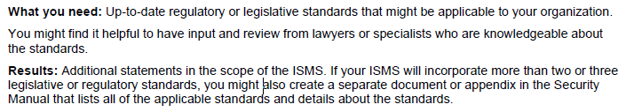
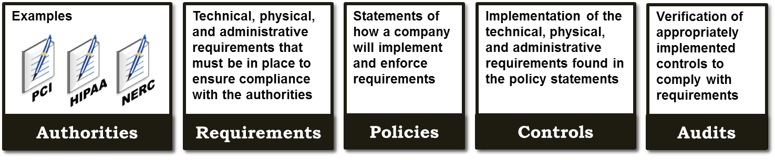
Applicable Legislation - Authorities

Slide 59
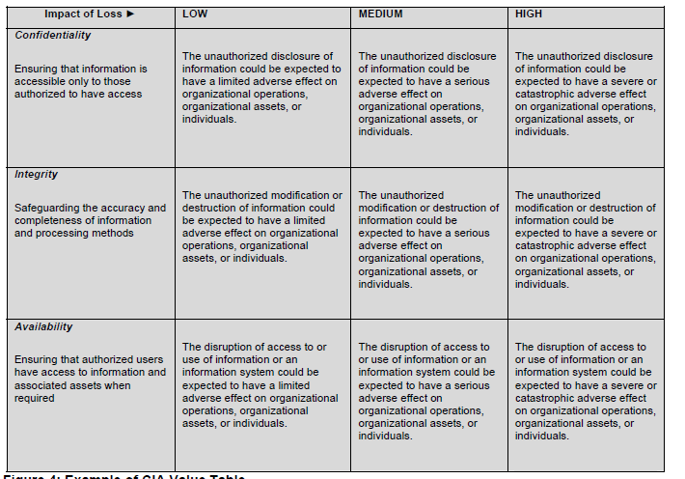
Risk Assessment

Slide 60
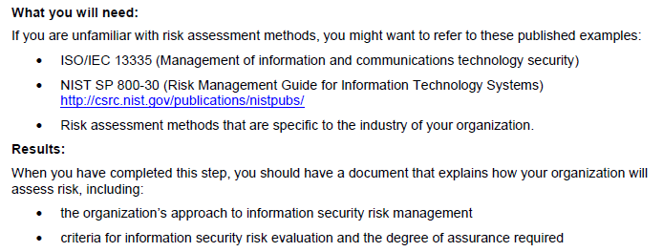
Risk Assessment

Slide 61
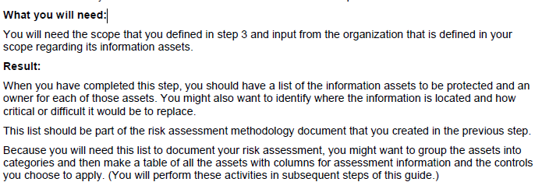
Inventory

Slide 62
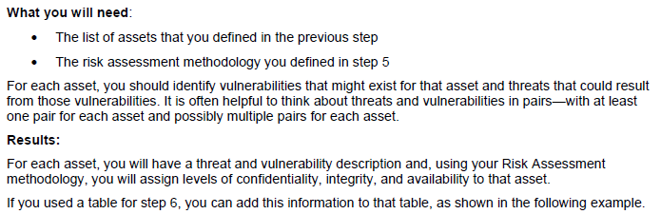
Identify Risk

Slide 63
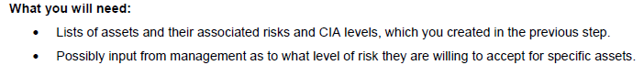
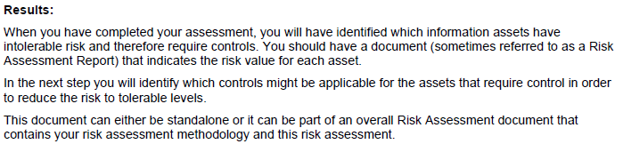
Assess Risk

Slide 64
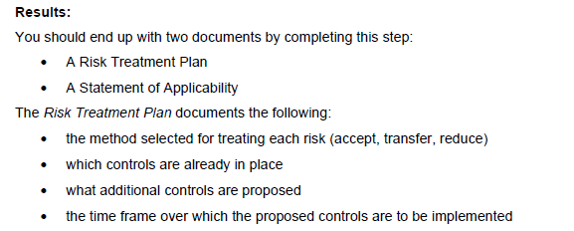
Identify Objectives and Controls

Slide 65
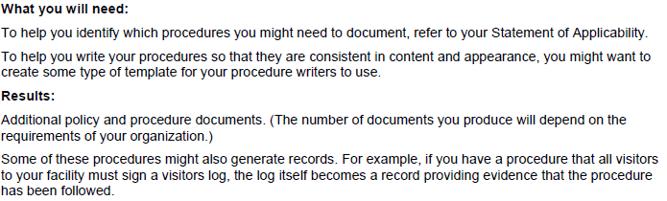
Policies and Procedures

Slide 66
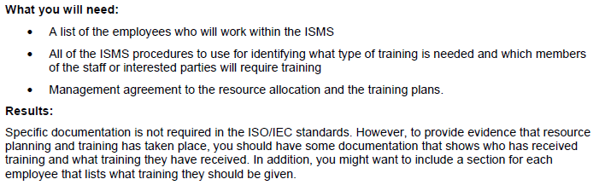
Allocate Resources and Train

Slide 67
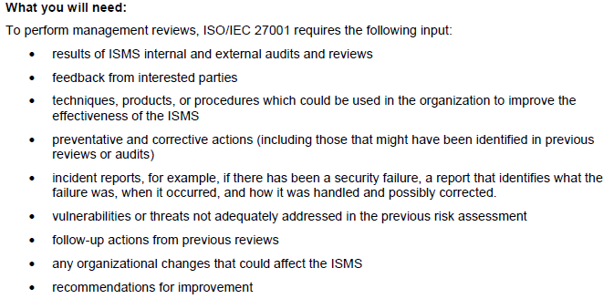
Monitor Implementation

Slide 68
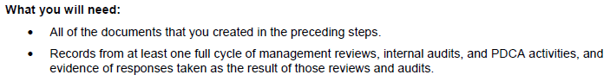
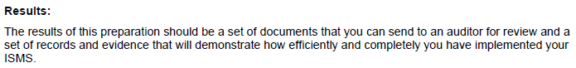
Certification and Help

Slide 69
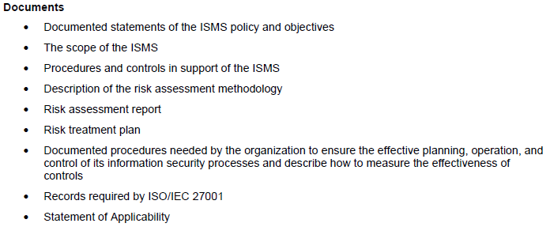
Documents

Slide 70
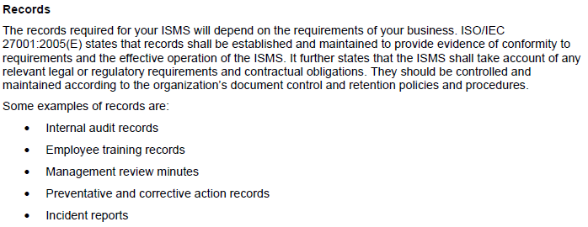
Records

Slide 71
Elements of an Information Security Program - Summary
Joint responsibility of business, information security, and IT management
Integrated with corporate business objectives
Requirements are clearly defined, optimized, and included in a security plan
Security functions are integrated with applications at the design stage
End users are accountable for managing security
Incidents are addressed with formalized incident response procedures supported by automated tools
Periodic security assessments evaluate the effectiveness of implementation of the security plan
Information on new threats and vulnerabilities is systematically collected and analyzed
Mitigating controls are communicated and implemented
Intrusion testing, root cause analysis of security incidents and proactive identification of risk is the basis for continuous improvements
Security processes and technologies are integrated organization-wide
71
Notes:
Demo - sample security teleconference slides.

Slide 72
Final Thoughts

Slide 73
Final Thoughts

Slide 74
From Authorities to Audits
Examples
Technical, physical, and administrative requirements that must be in place to ensure compliance with the authorities
Statements of how a company will implement and enforce requirements
Implementation of the technical, physical, and administrative requirements found in the policy statements
Verification of appropriately implemented controls to comply with requirements
PCI
HIPAA
NERC
Authorities
Requirements
Policies
Controls
Audits
PCI-DSS Example
Authority: PCI-DSS is the authority document created by the PCI-SSC.
Requirement: (10.6) Review logs for all system components at least daily.
Policy: Monitoring Policy – States logs will be reviewed at least daily.
Control: Tool XYZ provides real-time monitoring for all system components.
Audit: Auditor verifies Tool XYZ is appropriately monitoring and alerting to actionable events. Audit results and evidence are stored as part of the audit.

Slide 75
Effectively Managed IT Controls
Technology can affect every part of the business.
At its best, technology is a competitive advantage.
At its worst, technology is your competitor’s advantage.
Product
Market Relationships
IT Controls:
Detective, protective and reactive measures in place to protect the confidentiality, integrity, and availability of business information and ensure appropriate management of the IT function to meet business objectives.
Inbound Logistics
Operations
Outbound Logistics
Marketing
and Sales
Service
Firm Infrastructure
HR Management
Margin
Procurement
Technology Development
Notes:
Compliance Control: A process, effected by management and other personnel, designed to provide reasonable assurance that transactions are executed in accordance with 1) laws governing the use of budget authority and other laws and regulations that could have a direct and material effect on the financial statements or required supplementary stewardship information and 2) any other laws, regulations, and government wide policies identified in OMB audit guidance. [GAO/PCIE Financial Audit Manual]
Source: http://www.unifiedcompliance.com/it_compliance/language_compliance/definitions/c.html

Slide 76
Chris Davis
UTD Email: cmd140430@utdallas.edu
Google Voice: 214-771-8122
Course Materials
https://elearning.utdallas.edu

Slide 77
Additional Materials

Slide 78
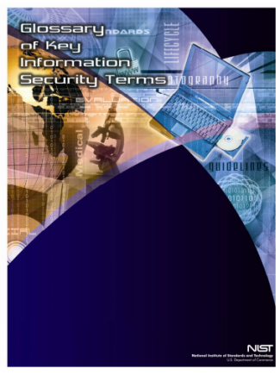
IR7298-rev1 Glossary of Key Information Security Terms
Defining Information Security

Slide 79

What is Information Security
The protection of information and information systems from unauthorized access, use, disclosure, disruption, modification, or destruction in order to provide confidentiality, integrity, and availability.
SOURCE: SP 800-37; SP 800-53; SP 800-53A; SP 800-18; SP 800-60; CNSSI-4009; FIPS 200; FIPS 199; 44 U.S.C., Sec. 3542
IR7298-rev1 Glossary of Key
Information Security Terms

Slide 80

Information Security
IR7298-rev1 Glossary of Key
Information Security Terms
Information Security – Protecting information and information systems from unauthorized access, use, disclosure, disruption, modification, or destruction in order to provide—
1) integrity, which means guarding against improper information modification or destruction, and includes ensuring information nonrepudiation and authenticity;
2) confidentiality, which means preserving authorized restrictions on access and disclosure, including means for protecting personal privacy and proprietary information; and
3) availability, which means ensuring timely and reliable access to and use of information.
SOURCE: SP 800-66; 44 U.S.C., Sec 3541

